Slide 1
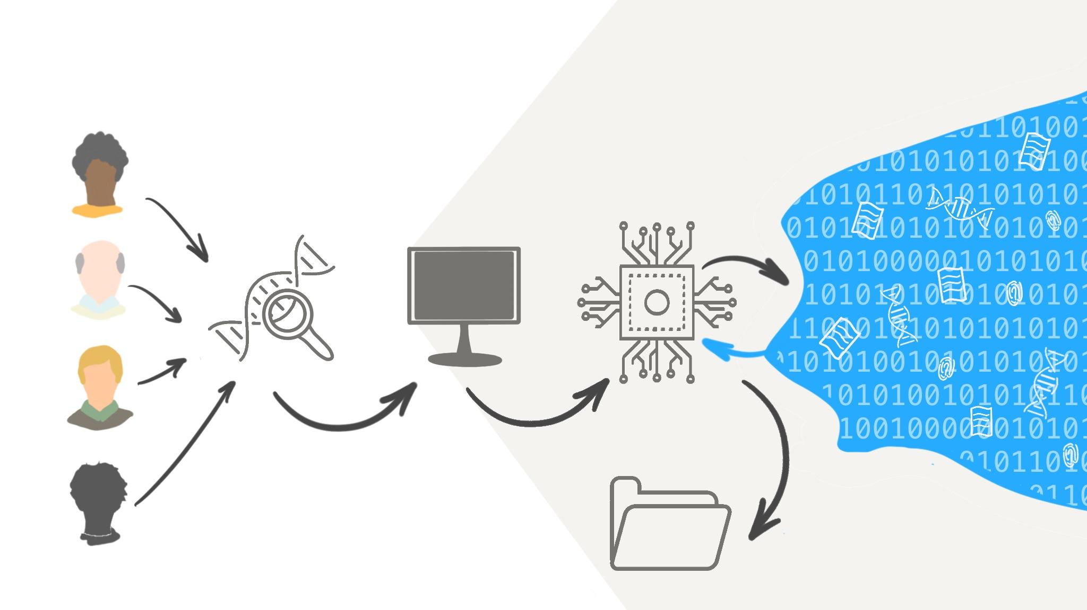
Agent System in Digital Forensics (Group 4)
Multi-Agent System in Digital Forensics
(Group 4)

Slide 2
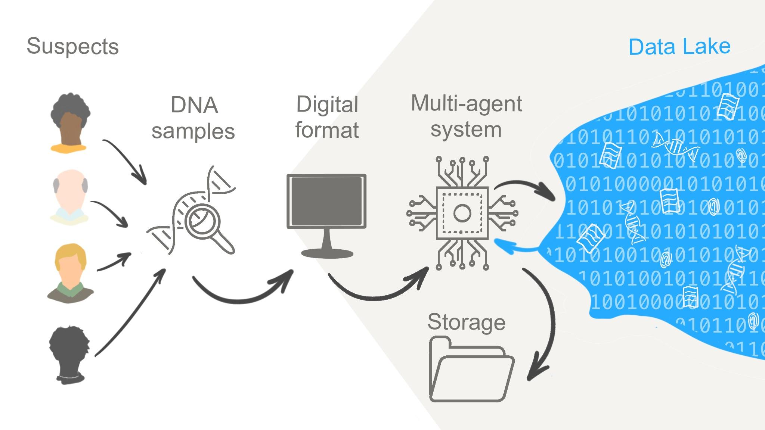
Introduction

Slide 3
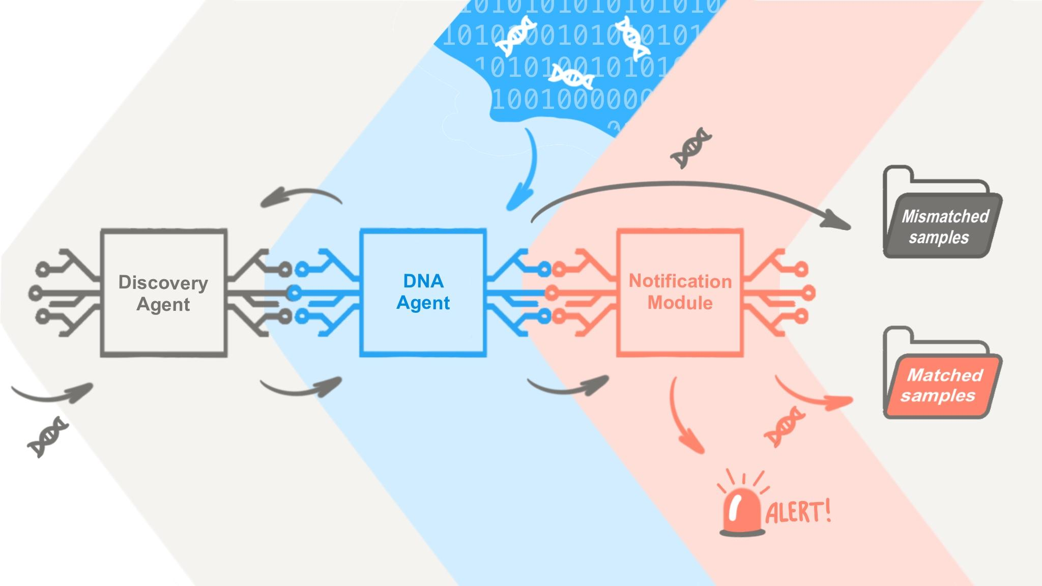
The general idea of the architecture

Slide 4
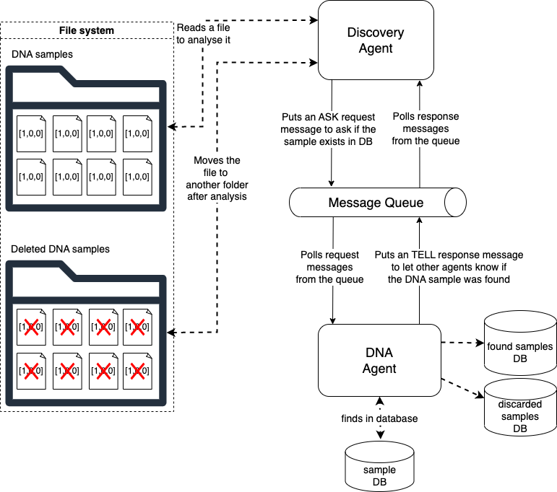
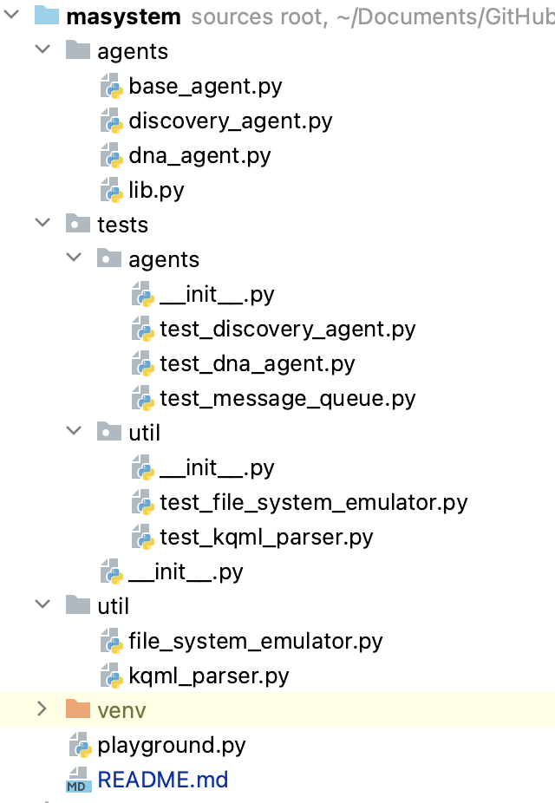
Development of the architecture

Slide 5
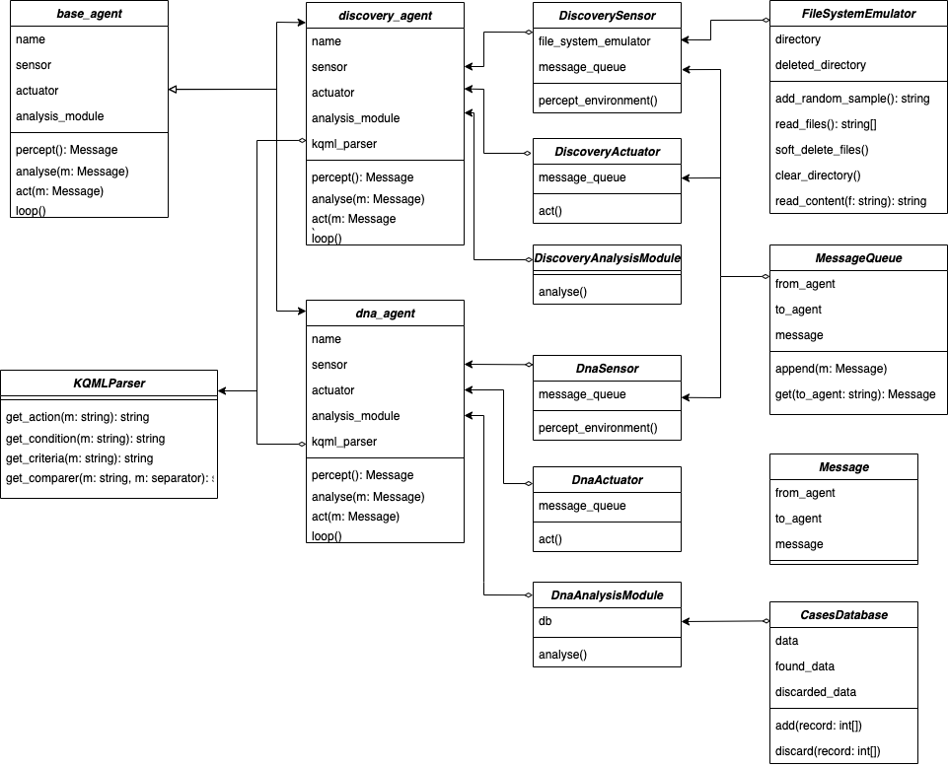
Class diagram
Three main steps for MAS designing (Maalal & Addou, 2012):
1. Maintain consistent titles for classes and associations within the diagrams.
2. Include roles, perceptions, intentions, representations of each agent in the attribute section of the UML class.
3. Consolidate all methods or functions within the operations section of the UML class.

Slide 6
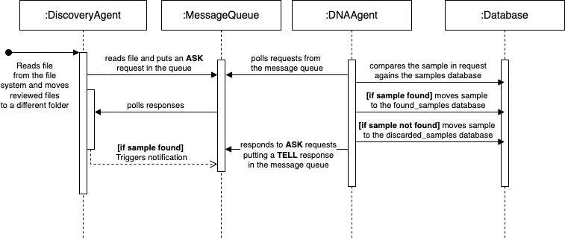
Sequence diagram

Slide 7
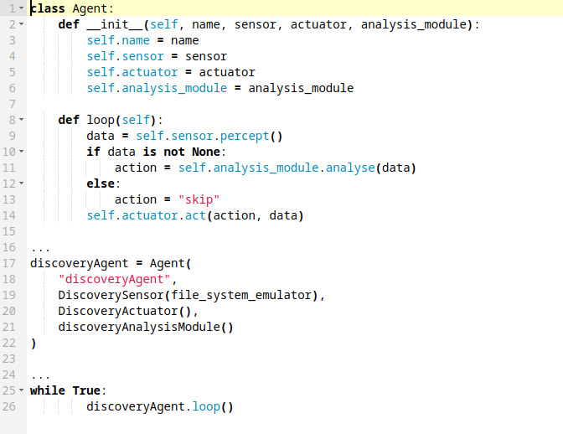
Class Agent code example
"Different agents have different spheres of influence, in the sense that they have control on different parts of the environment."
(Maalal & Addou, 2012)

Slide 8
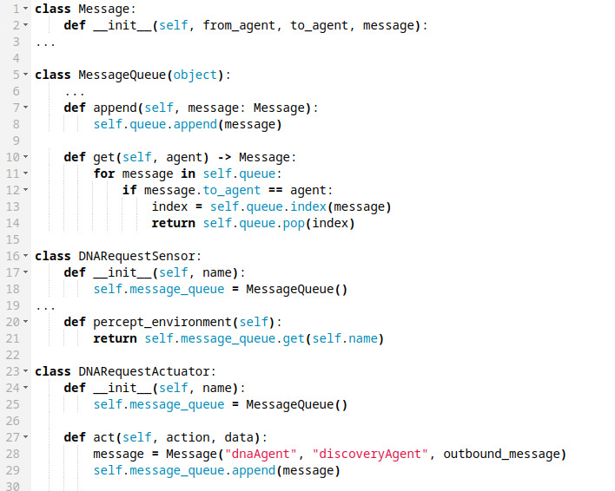
Class Message code example
"Despite benefits of reaching an agreement, agent negotiations process is presumed as a costly and time consuming practice" (Mahdi et al., 2010).

Slide 9
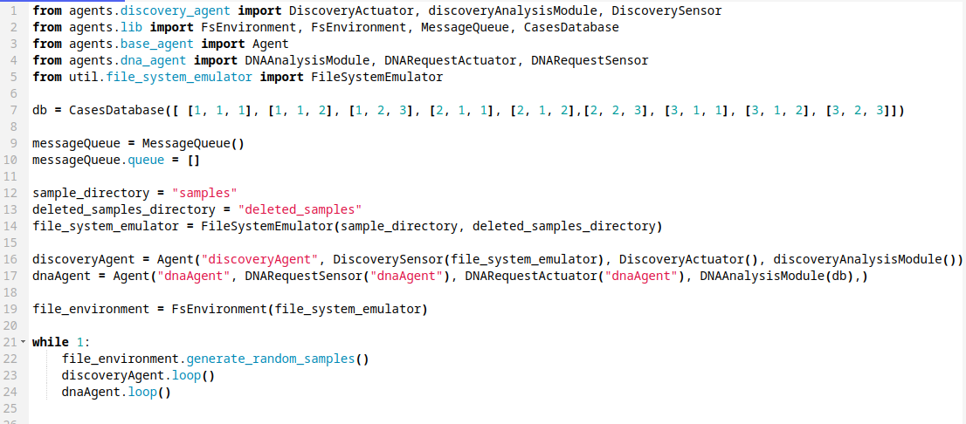
Testing the code

Slide 10

Working code example

Slide 11
References
Bergenti, F. & Poggi, A. (2000) Exploiting UML in the design of multi-agent systems. In Engineering Societies in the Agents World: First International Workshop, ESAW 2000 Berlin, Germany, August 21, 2000 Revised Papers 1 (pp. 106-113). Springer Berlin Heidelberg.
Bianchi, L. & Liò, P. (2007) Forensic DNA and bioinformatics. Briefings in bioinformatics, 8(2), pp.117-128.
Finin, T., Fritzson, R., McKay, D. & McEntire, R. (1994) KQML as an agent communication language. In Proceedings of the third international conference on Information and knowledge management (pp. 456-463).
Kendrick, P., Hussain, A.J. & Criado, N. (2016) Multi-agent systems for dynamic forensic investigation. In Intelligent Computing Theories and Application: 12th International Conference, ICIC 2016, Lanzhou, China, August 2-5, 2016, Proceedings, Part I 12 (pp. 796-807). Springer International Publishing.
Leslie, D. (2019). Understanding artificial intelligence ethics and safety. The Alan Turing Institute. https://doi.org/10.5281/zenodo.3240529
Maalal, S. & Addou, M. (2012) A new approach of designing Multi-Agent Systems. arXiv preprint arXiv:1204.1581.
Mahdi, G., Gouaïch, A. & Michel, F., 2010, May. Real-time Coordination Of Multi-Agent Systems: An Integrated View. In AAMAS'10: Agents in Real-time and Dynamic Environments Workshop (pp. N-A).
Nahm, Y.E. & Ishikawa, H. (2005) A hybrid multi-agent system architecture for enterprise integration using computer networks. Robotics and Computer-Integrated Manufacturing, 21(3), pp.217-234.
Shtrauss, A. (2023) Biopython | Bioinformatics Basics. Available from: https://www.kaggle.com/code/shtrausslearning/biopython-bioinformatics-basics [Accessed 8 Jun 2023]
Soon, G.K., On, C.K., Anthony, P. & Hamdan, A.R. (2019) A review on agent communication language. Computational Science and Technology: 5th ICCST 2018, Kota Kinabalu, Malaysia, 29-30 August 2018, pp.481-491.
Terra, J. (2023) Exploring Intelligent Agents in Artificial Intelligence. AI & Machine Learning Course on SimpliLearn. Available from: https://www.simplilearn.com/what-is-intelligent-agen-in-ai-types-function-article [Accessed 10 Jun 2023]
Tomar, A. (2021) Microservices Orchestration vs Choreography | (Technology). Available from https://medium.com/geekculture/microservices-orchestration-vs-choreography-technology-5dbe612cf7e9 [Accessed on 14 Jul 2023]
Twardowski, B. & Ryzko, D. (2014) Multi-agent architecture for real-time big data processing. In 2014 IEEE/WIC/ACM International Joint Conferences on Web Intelligence (WI) and Intelligent Agent Technologies (IAT) (Vol. 3, pp. 333-337). IEEE.

